Slide 1
Project Update
Jackson Magas

Slide 2
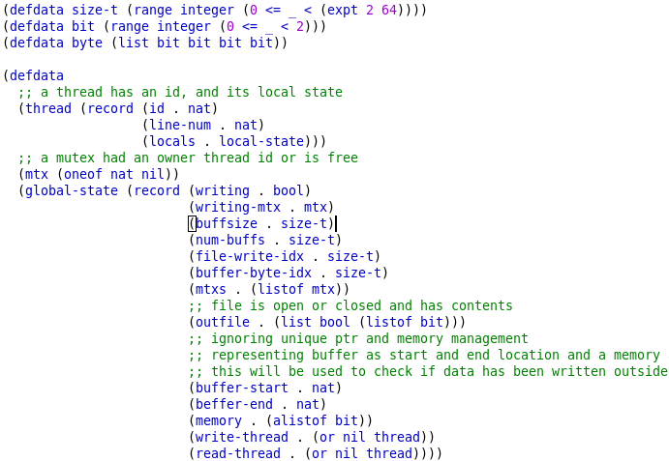
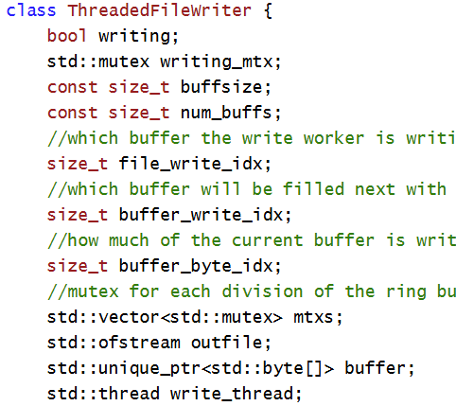
Defined Data Types for Class Members (global state)

Slide 3
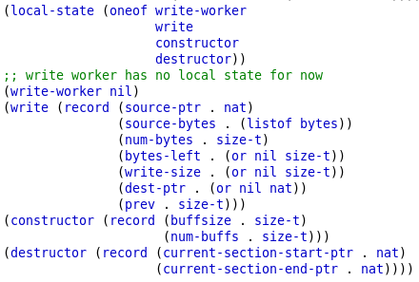
Defined Local State for Each Function
Includes parameters and all local variables defined

Slide 4
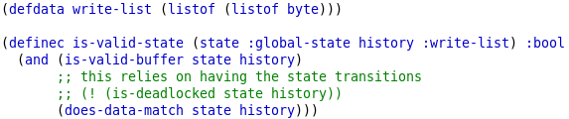
Created Skeleton for Valid State Predicate
Takes any state and history of inputs to the program and determines if the state is valid given the inputs.
Valid memory:
everything in the memory is within the bounds of the buffer
Data continuity:
the history is exactly the output file plus some amount of the memory after the write index in the buffer

